Slide 1

CODEBASICS RESUME CHALLENGE – November 2022 Designed and Presented By RAJESH KUMAR

Slide 2

Company’s Background
AtliQ

Slide 3
Company’s Background
AtliQ
Telecom Provider
in India

Slide 4
Company’s Background
Atliq
Telecom Provider
It’s Operates 15 Cities
in India
Mumbai
Delhi
Kolkata
Bangalore
Chennai
Hyderabad
Pune
Ahmedabad
Jaipur
Lucknow
Patna
Coimbatore
Chandigarh
Gurgaon
Raipur

Slide 5
Problem Statement
The management noticed a decline in their Active users and Revenue growth post 5G launch in May 2022.
Their analytics team to provide a comparison report of KPIs between pre and post-periods of the 5G launch.

Slide 6
Key metrics:-
Total Revenue
Average Revenue per user(ARPU)
Monthly Active users
Monthly Unsubscribed users
Market share %

Slide 7
Expected outcome after this analysis?
Comparing between the Before & After 5G to regain the market share over months for all companies
Understanding their internet plans revenue to get more active users.
To get insights where business is failing and what can be done to tackle them

Slide 8
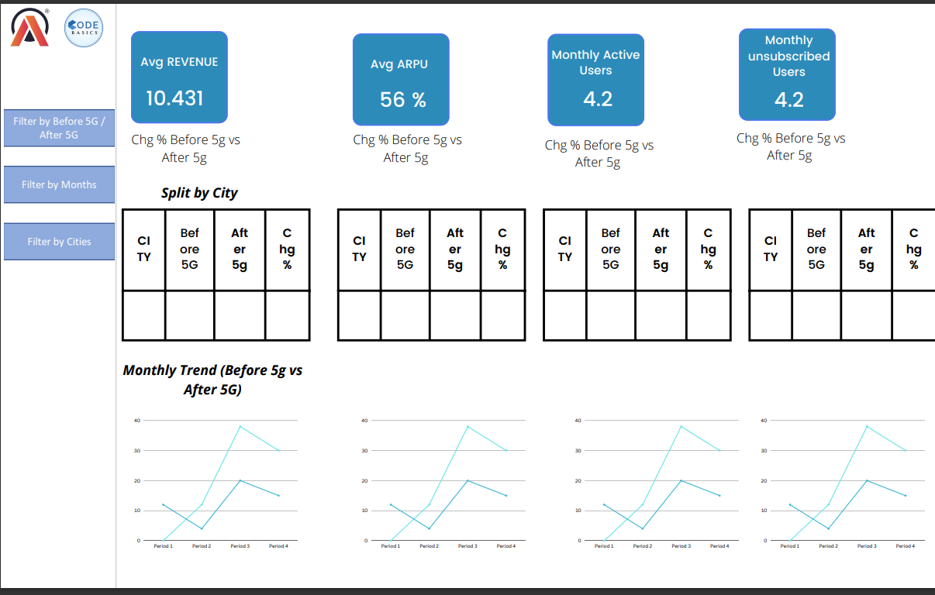
Mock-up Dashboard:-
Market share over months for all companies
Top Plan By Revenue

Slide 9
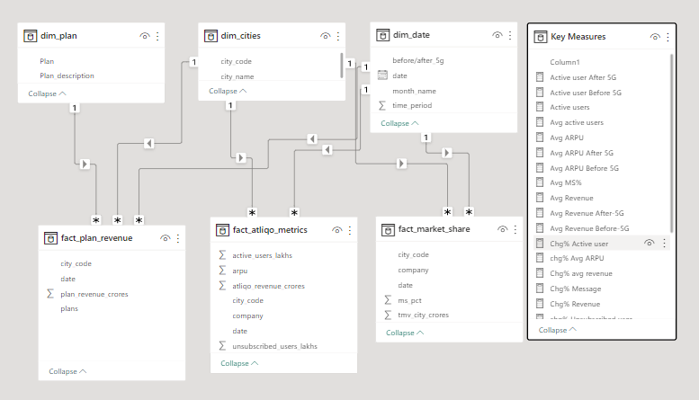
Data Modeling

Slide 10
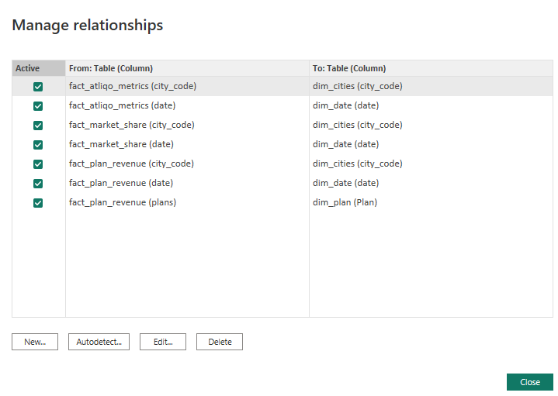
Relationship between the table

Slide 11
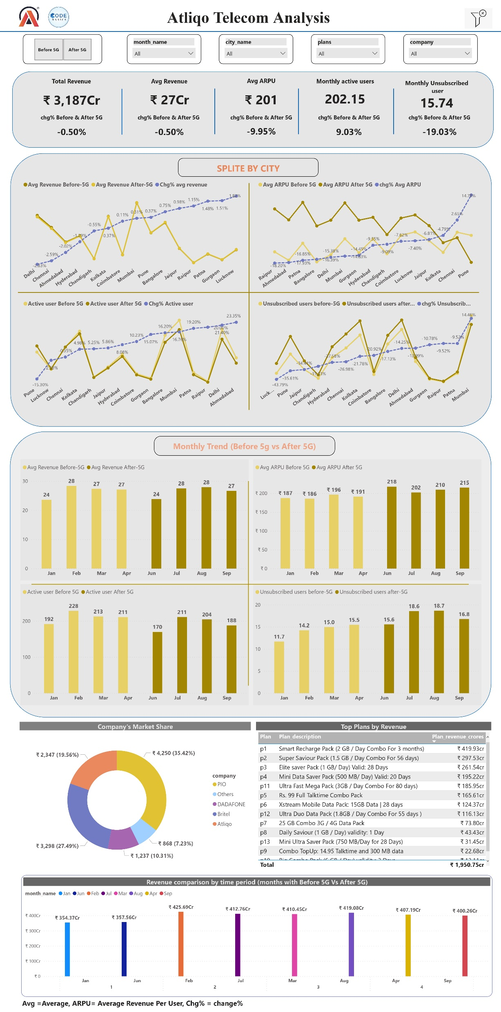
Dashboard

Slide 12
Insights
Atliqo telecom generated Total Revenue of 3,187 Crore it's Average revenue is 27 crore and comparison between Before & after5G their gradual decreasing in Revenue Change% of -0.50%(8 Crore) after 5G implementation
There is increasing in Average revenue per user(ARPU) After Implementing the 5G is 9.95% (21 crores).
Average Monthly active users is decreasing the implementation after 5G of 18 lakhs users(9.93%). Average Monthly Unsubscribed users increase in the implementation after 5G of 4 lakhs users (19.03%).
The top 5 plans according to revenue are p1, p2, p3, p4 and p11.
Atliqo Market share is 19.56% with the different competitor in the telecom industry, Highest market share is PIO=35.42%, Britel= 27.49%, DADAFONE=10.31%, , Others=7.23%.
It's is new 5G technology if companies give promotional offer to increase the customer Engagement and Revenue

